Slide 1
DEFAULTERS
CASE STUDY
Aniruddha Arthshi

Slide 2

Overview Of Datasets
This presentation covers two primary datasets:
•1. Clients.csv - Contains client details.
•2. Payments.csv - Contains transaction details.
•These datasets are merged based on 'client_id' to perform enriched analysis.

Slide 3
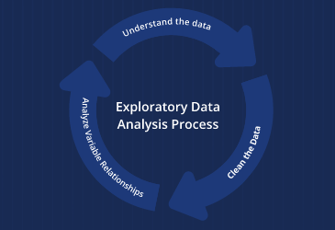
Data Merging and EDA
•Merging details:
•- Duplicate identification and handling.
•- Merging records on 'client_id' to correlate payments with client profiles.

Slide 4



Analysis of Default Payments
Analysis focuses on default payments by client and entity type, highlighting days, year and trends.

Slide 5
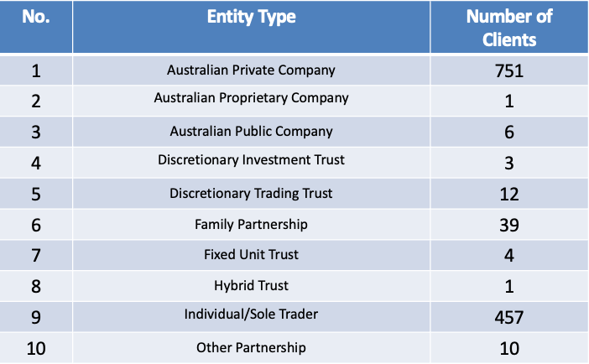
Analysis of Default Clients

Slide 6
Analysis
•There are total 368 default clients out of 1287 clients.
•In the Australian Private Company entity, they have 195 defaulters.
•In the Individual/Sole Trader entity have 150 defaulters.
•The client who have done 34 default transactions is client 859, which comes under Australian Private Company.

Slide 7
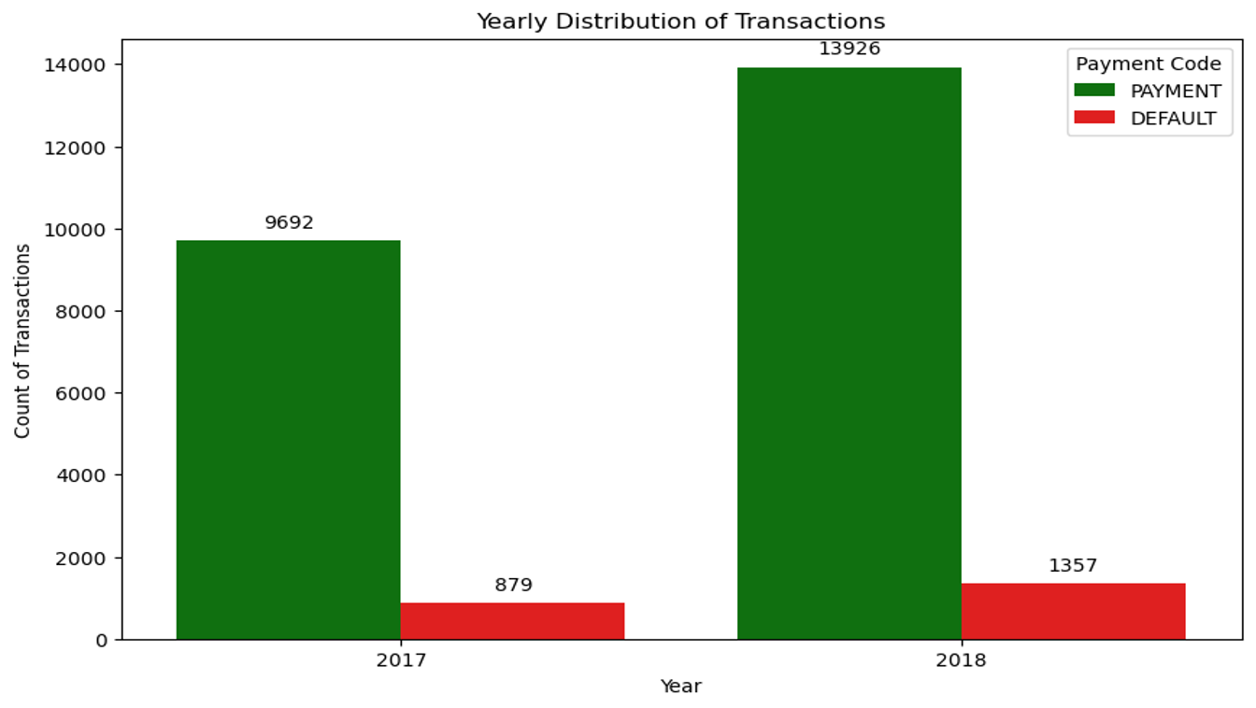
Yearly Distribution of Transactions

Slide 8
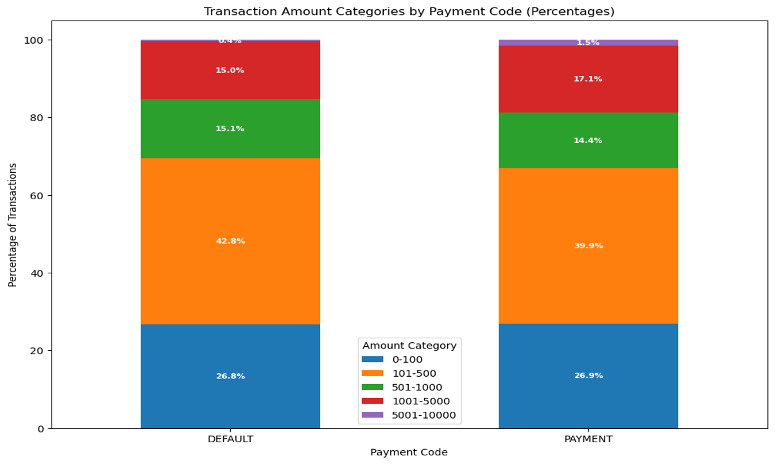
Transaction Amount Categories by Payment and default along with Percentage

Slide 9
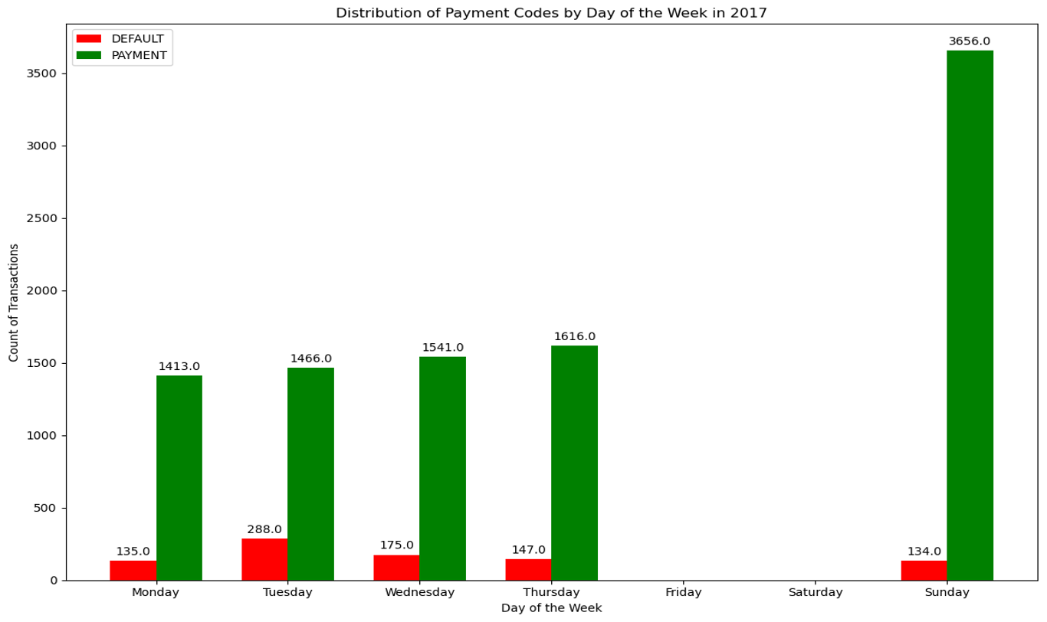
Transaction in the year 2017 by week

Slide 10
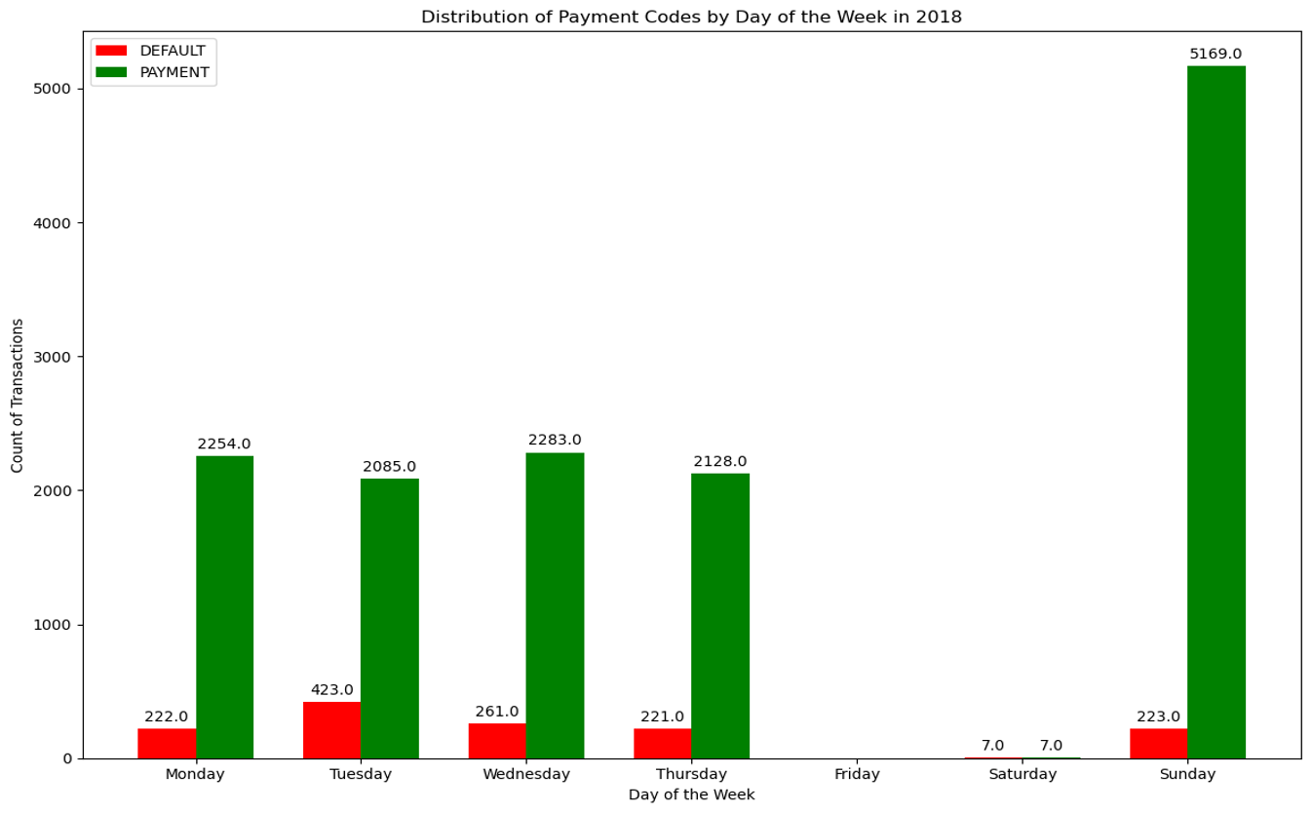
Transaction in the year 2018 by week

Slide 11
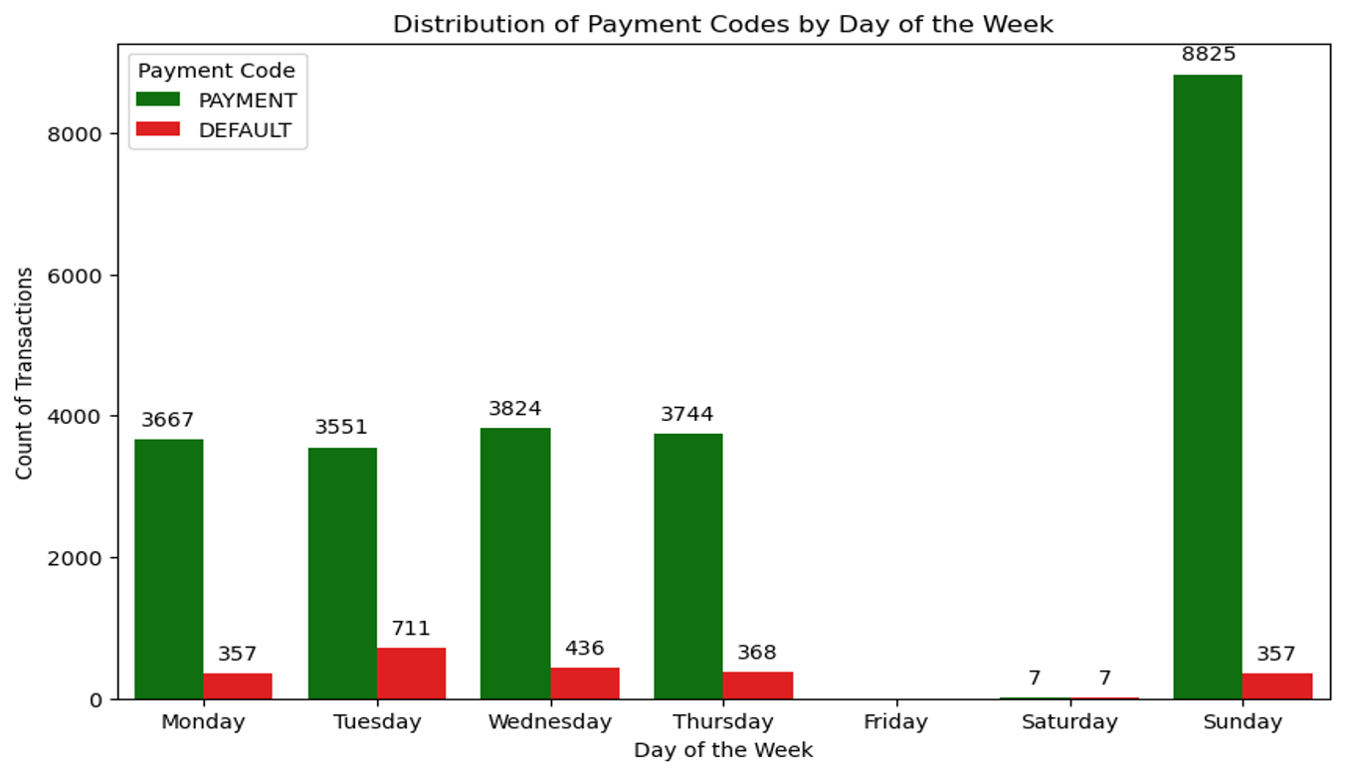
Transactions of payments and defaults by week

Slide 12
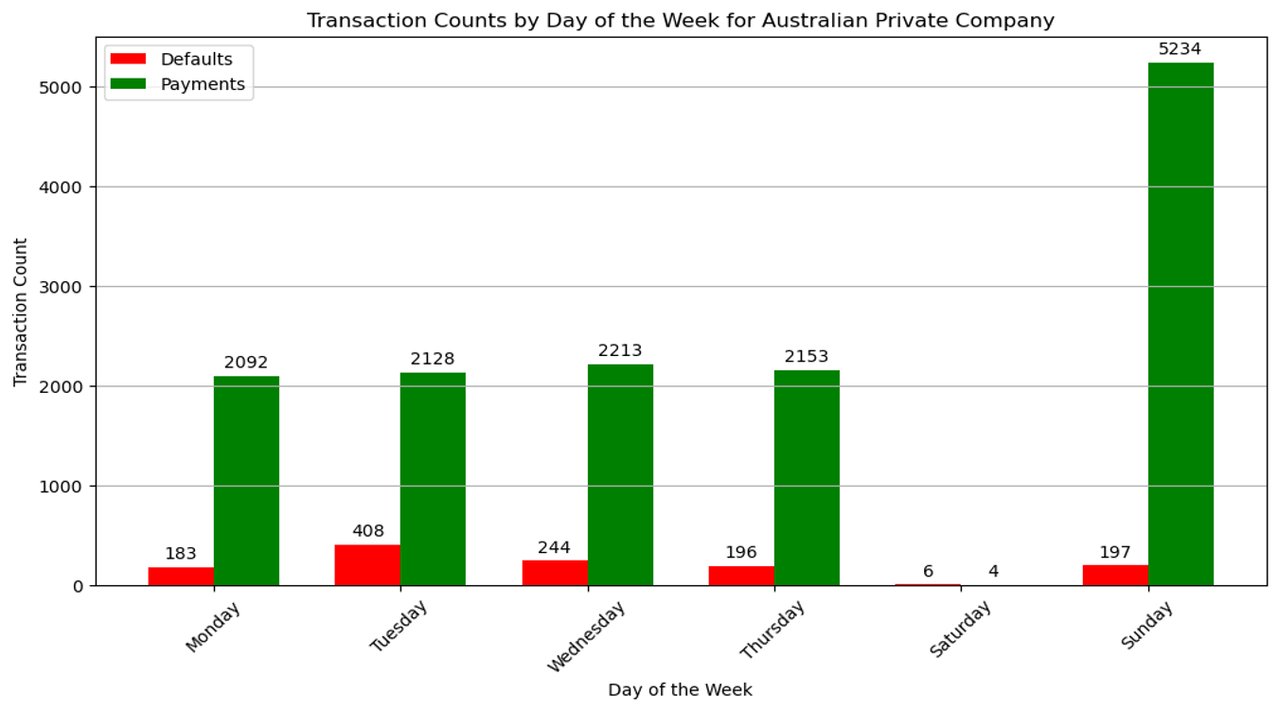
Transactions of Australian Private Company by week

Slide 13
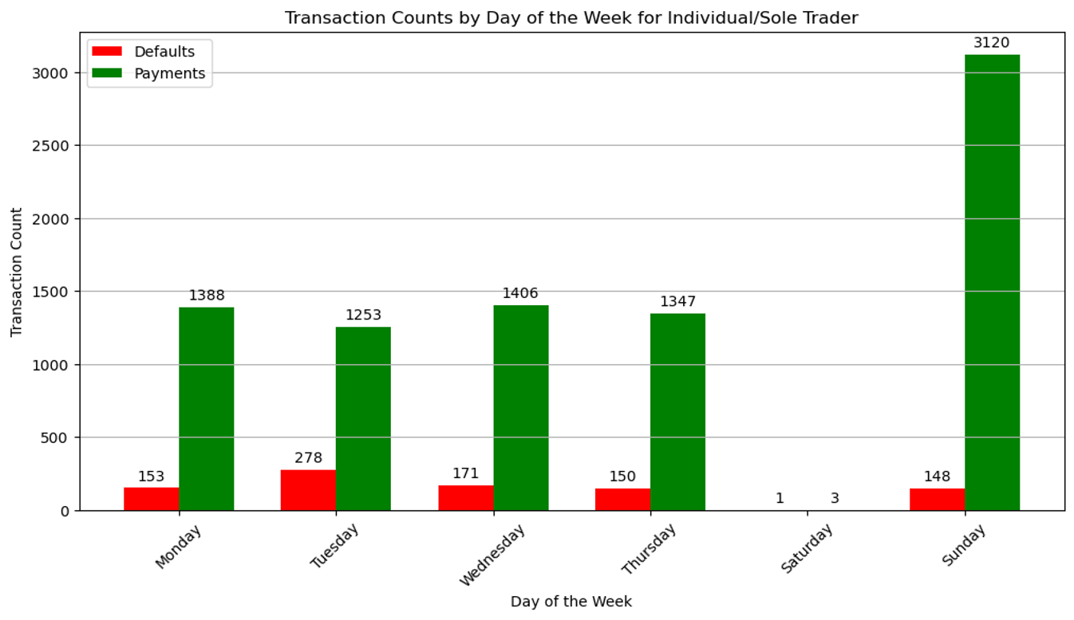
Transaction of Individual/Sole Trader by week

Slide 14
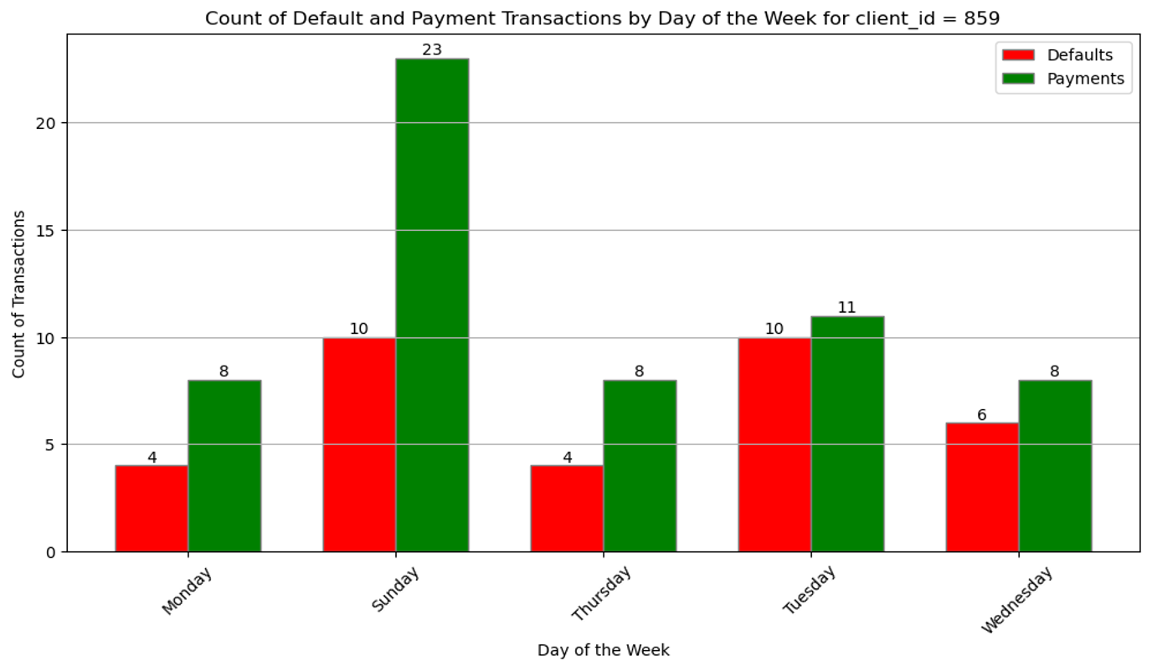
Transactions for Client 859 by week

Slide 15
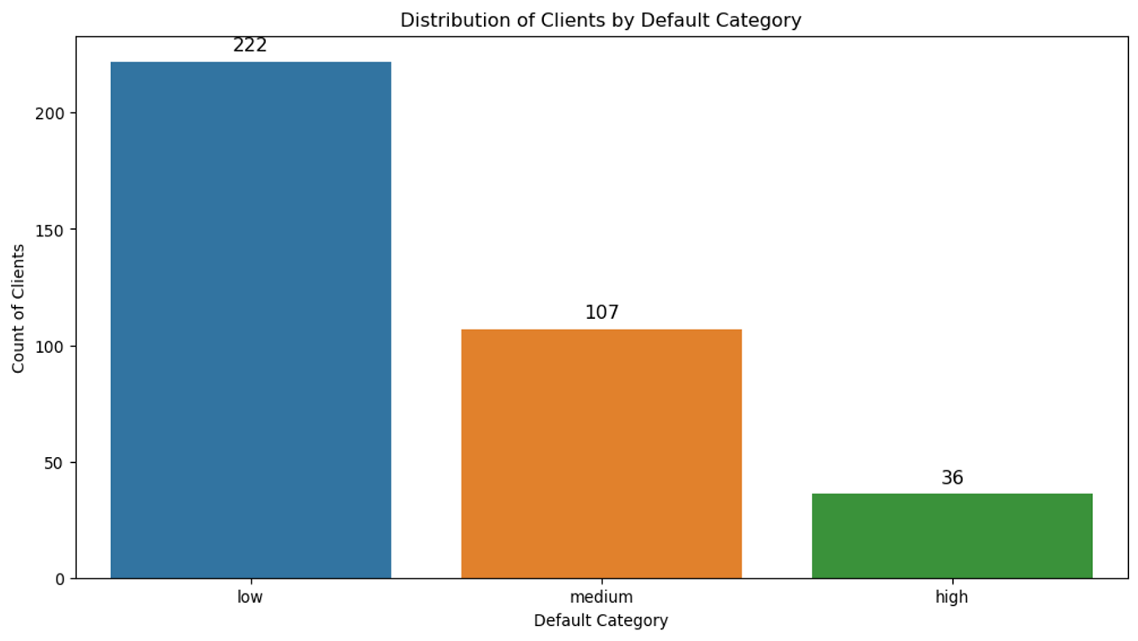
Defaulters by Category

Slide 16
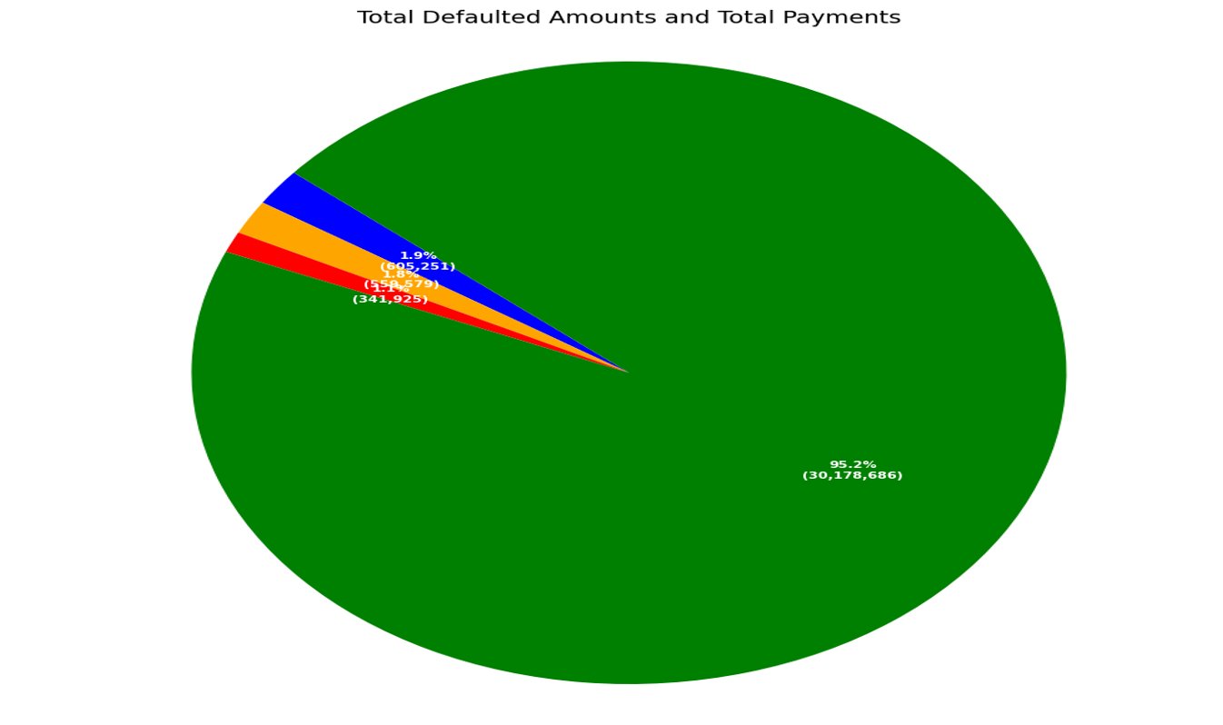
Defaulted Amount and Percentage

Slide 17


Payment defaults are detrimental to the business and are a significant cost factor. Are there any key trends in the data which can help me avoid default-prone customers in the future?

Slide 18


•High number of payments on Sunday, according to 2017-2018.
•The total defaulted amount in 2017 was 403486.68 and 1103269.19 in 2018, which sum up to 1.5 million.
•The total defaulted amount is 5% of total payments made in 2017-2018.
• Sending reminder to the client prior to the due date of payment can help in reducing default payments.

Slide 19


•Entity types like "Australian Private Company" and "Individual/Sole Trader" are frequently among medium and high defaulters, setting stricter rules for defaulters such as penalty of certain percent based on the payment amount.
•Clients who have previously defaulted payments, monitoring client payment history closely to identify patterns of missed payments could help in preventing future defaults.

Slide 20




Conclusions
The analysis helps understand payment behaviors and defaulter profiles, helps in strategic decision-making.

Slide 21
THANK YOU

